Slide 1
Algorithmic Solution of
Indoor Luminaire Placement
Rudolf Bayer, Michal Brejcha, Zuzana Panská
CTU in Prague

Slide 2
Project goals
Use of a genetic algorithm to place luminaires in a model room
Respect standard ČSN EN 12464-1 (lighting of indoor work places)
Find the best solution

Slide 3


ČSN EN 12464-1
Light and lighting - Lighting of work places - Part 1: Indoor work places
Mandatory in ČR
Model room
  Function: handwriting, typewriters, reading, processing data (5.26.2)
    Maintained average illuminance lx
    Unified glare rating 19
    Lighting uniformity
    General color rendering index 80

Slide 4
Genetic algorithm
In the field of artificial intelligence, a genetic algorithm is a search heuristic that mimics the process of natural selection.

Slide 5
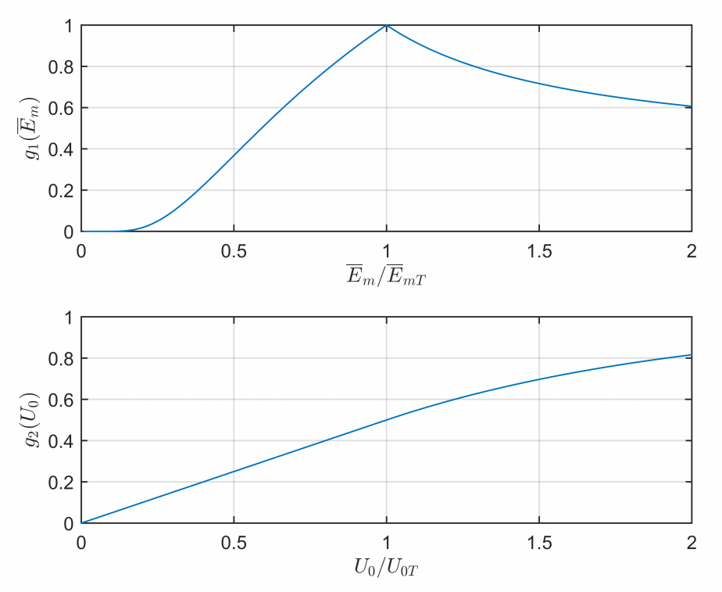
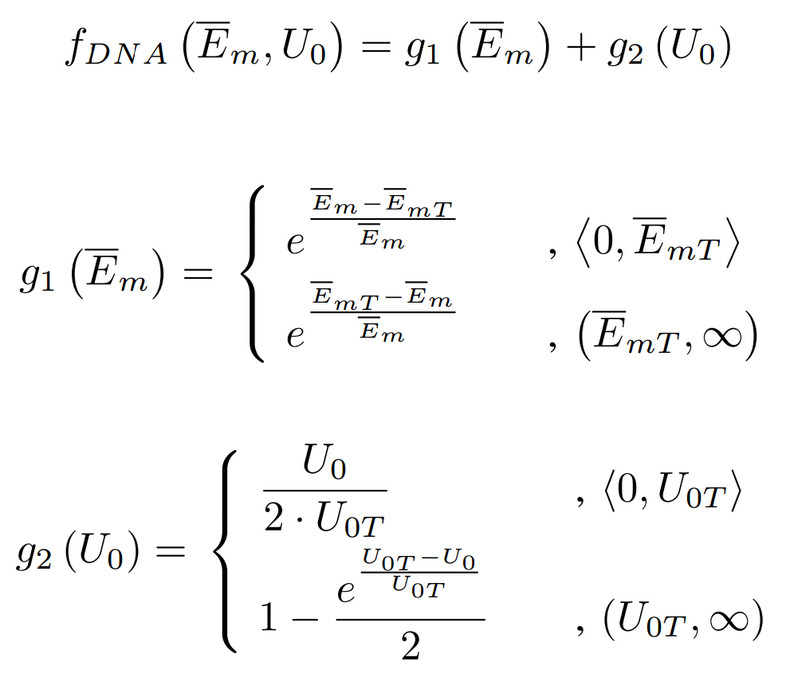
Fitness function
  Calculates the quality of a single solution (phenotype)

Slide 6
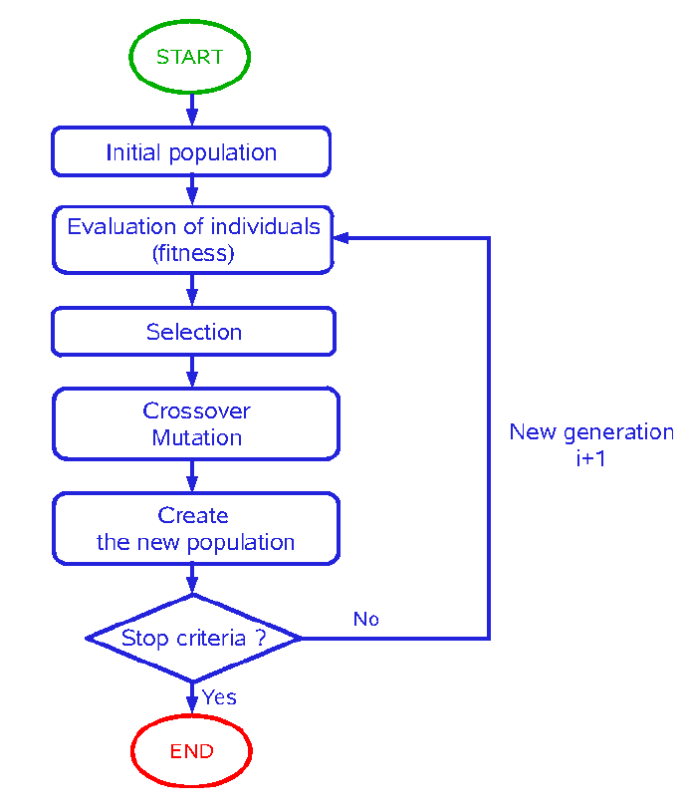
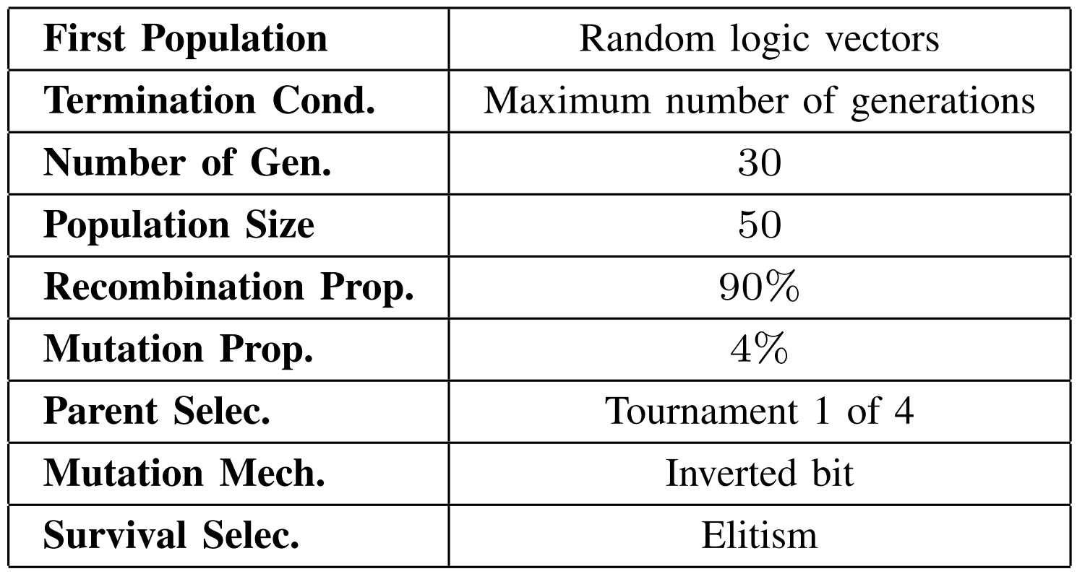
Genetic algorithm sequence
New generation
[1]

Slide 7
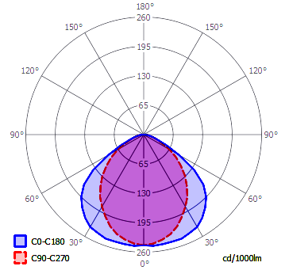
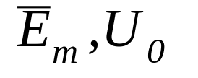
Model room
Model room properties
  Dimension: length 10 m, depth 5 m, height 4 m
  Luminaires mounted 0.5 m bellow the ceiling
  Horizontal working plane 0.75 m above the floor
Watched working plane values:
Luminous intensity distribution curve was taken from software “Building design”

Slide 8
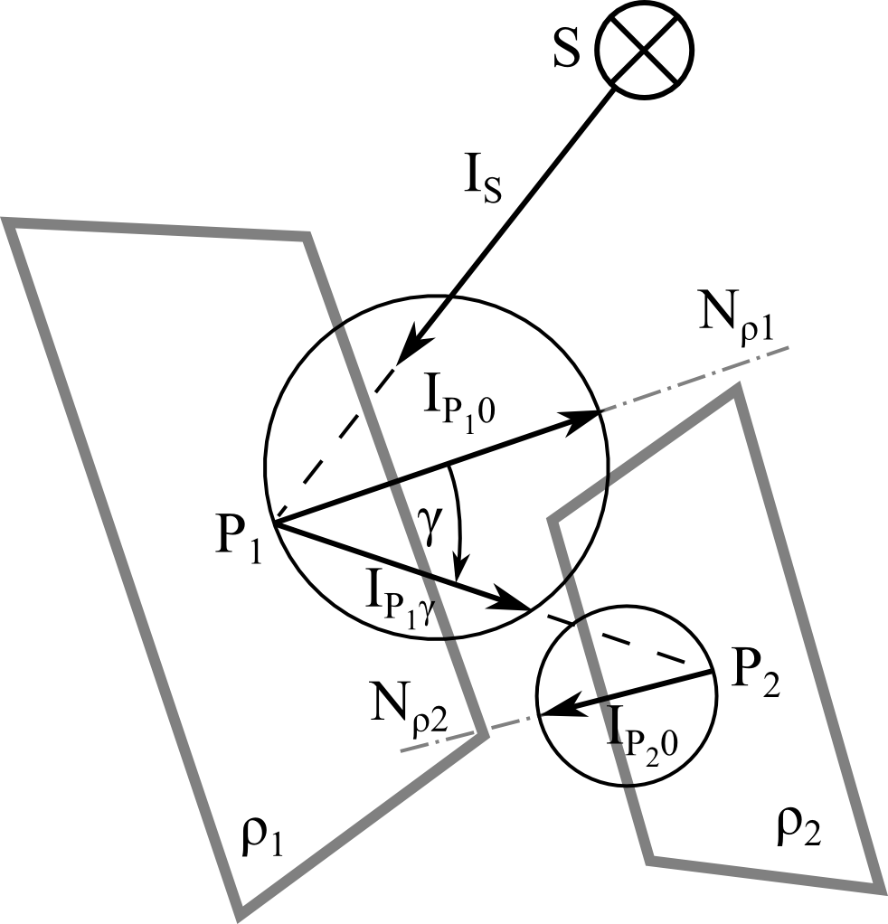
Lighting model - Radiosity
Lambertian reflectance
  surfaces exhibit diffuse reflectance
Finite element method
  surfaces are divided into facets
  current model room facets:
    25 x 25 cm
    square-shaped
Amount of reflections: 4

Slide 9
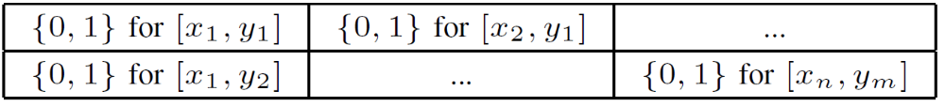
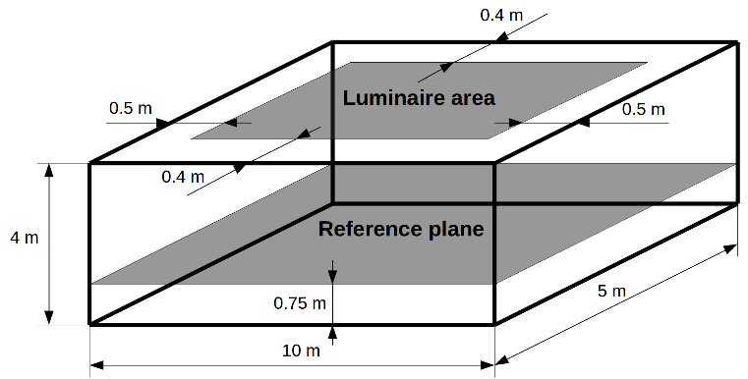
Used genotype
Chromosome - Logical vector of luminaire presence in the grid:
Grid of allowed positions:
  0.6 m between luminaires
  Central or axis symmetry

Slide 10
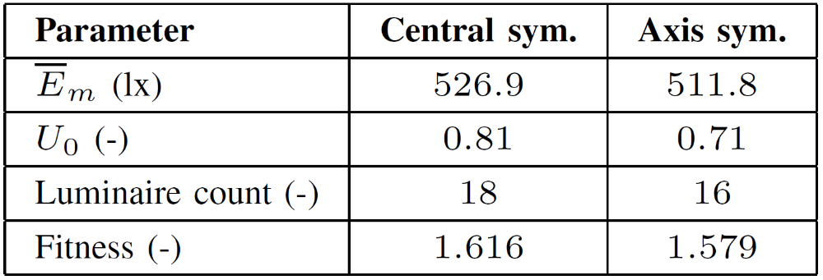
Results

Slide 11
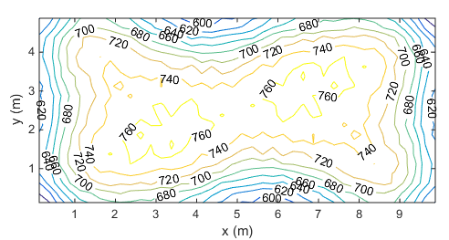
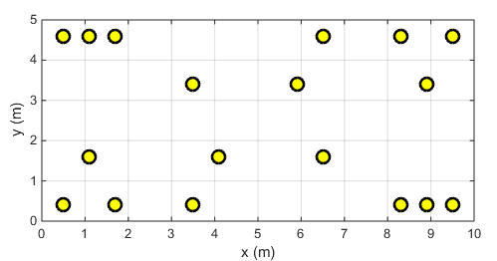
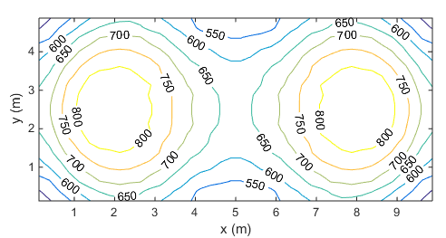
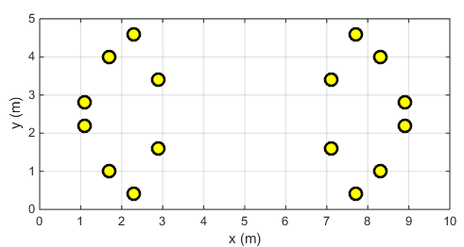
Results
Central symmetry
Axis symmetry

Slide 12
Conclusion
  Results satisfies the standard requirements
  Long time of calculations – reflections
  Solutions are restricted by the grid
  Change in count of luminaires between generations is restricted by the symmetry
  Current fitness function does not respect designers preferences (least luminaire count, higher illuminance etc.)

Slide 13
Thank you for your attention

